Slide 1
CS 290– Web Development.

Slide 2
Agenda
Review what we did last class
Express.js
Use POSTMAN

Slide 3
npm install body-parser
body-parser extract the body portion of an incoming request stream and exposes it on req.body
It’s a middleware library. In many platforms, like php and perl, the parser automatically takes care of the tasks we use body-parser for in Node.

Slide 4
Updating express
C9 comes with a really old version so we'll uninstall and reinstall express
Open bash terminal
npm uninstall express
You should see the express folder under node_modules disappear
npm install express
What version did it install?

Slide 5
Lets start
Backup your server.js -either comment it, copy it to a separate file or to your local machine - and replace current code with the following code
var express = require('express');
var app = express();
app.get('/', function (req, res) {
res.send('Hello Bend. <br/> Use POSTMAN and POST to me. I dare you!');
})
app.post('/', function (req, res) {
res.send('Hello Portland');
})
var server = app.listen(process.env.PORT, function () {
console.log("Server listening at"+ process.env.PORT);
})

Slide 6
Run Server.js
Confirm you see the expected response on the url
Let's walkthrough what we did.

Slide 7
POST
To add a post, simply add the code below
app.post('/', function (req, res) {
res.send('Hello Portland');
})
Lets test it out using postman

Slide 8
The request object
Contains the HTTP request details
req.baseUrl - the url for the site
req.hostname - the hostname from the HTTP header
req.ip - remove ip address
req.params - parameters in the url
req.path - path portion of the url

Slide 9
Request object
req.protocol - http/https?
req.secure - a boolean that’s true if it’s a secure connection
You can also use req.headers or req.header('<propertyname>) to get properties

Slide 10
For example
Add this line to your get block
console.log("host=%s user-agent=%s ip=%s",
req.header('host'),
req.header('user-agent'),
req.header('x-forwarded-for'));

Slide 11
Response object
Res.headersSent - boolean that tells you if HTTP headers for the response were already sent
Methods of interest
res.append(field [,value]) : adds field and optional value to the HTTP response header
res.set(field[,value]) : sets the response HTTP headers field to value.

Slide 12
res.set('Content-Type', 'text/plain');
res.set({ 'Content-Type': 'text/plain',
'Content-Length': '123'});

Slide 13
Res.end - ends the response process.
Res.redirect - to redirect to a different page

Slide 14
An API
Domain/exchange/country
Gives you JSON info about that country
Domain /exchange/country1/country2/amount
Gives you json info of how much it would cost to convert 100 units of country-1's currency into country 2's currency.
Remember we are using USD as the common denominator

Slide 15
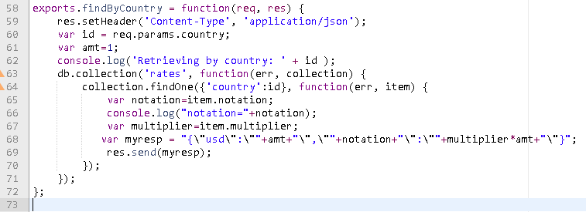
In server.js app.get('/exchange/:country',mydb.findByCountry);
In db.js
Notes:
exports.findByCountry = function(req, res) {
res.setHeader('Content-Type', 'application/json');
var id = req.params.country;
var amt=1;
console.log('Retrieving by country: ' + id );
db.collection('rates', function(err, collection) {
collection.findOne({'country':id}, function(err, item) {
var notation=item.notation;
console.log("notation="+notation);
var multiplier=item.multiplier;
var myresp = "{\"usd\":\""+amt+"\",\""+notation+"\":\""+multiplier*amt+"\"}";
res.send(myresp);
});
});
};

Slide 16
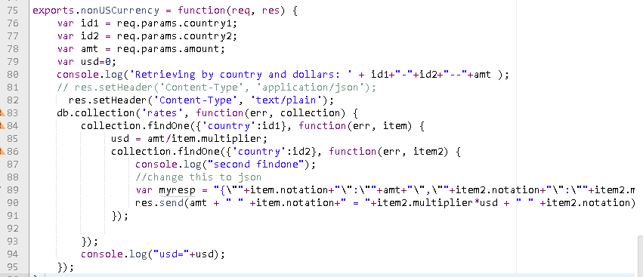
/exchange/country1/country2/amount
Notes:
exports.nonUSCurrency = function(req, res) {
var id1 = req.params.country1;
var id2 = req.params.country2;
var amt = req.params.amount;
var usd=0;
console.log('Retrieving by country and dollars: ' + id1+"-"+id2+"--"+amt );
// res.setHeader('Content-Type', 'application/json');
res.setHeader('Content-Type', 'text/plain');
db.collection('rates', function(err, collection) {
collection.findOne({'country':id1}, function(err, item) {
usd = amt/item.multiplier;
collection.findOne({'country':id2}, function(err, item2) {
console.log("second findone");
//change this to json
var myresp = "{\""+item.notation+"\":\""+amt+"\",\""+item2.notation+"\":\""+item2.multiplier*usd+"\"}";
res.send(amt + " " +item.notation+" = "+item2.multiplier*usd + " " +item2.notation);
});
});
console.log("usd="+usd);
});
};

Slide 17
Your assignment
Get the following items working.
GET /exchange/country1/country2/amount
PUT /exchange/country1
Put should work with a JSON string you pass as an argument
DELETE /exchange/country1
removes country1 from the dataase

Slide 19
Sending a File
Under Client folder, create a index.html
Add some simple html to this file (or copy/paste from somewhere)
Update your app.get code to include the blue line
app.get('/', function (req, res) {
res.sendFile(__dirname+'/client/index.html');
})
That’s two underscores before dirname
Run your server again.

Slide 20
Error handling
You can specify a function to handle any errors from sendFile by passing it a function handle
res.sendFile(__dirname+'/client/index2.html', function (err) {
if (err) { console.log(err); res.status(err.status).end(); } else { console.log('Sent:', fileName); }
});
This will spit out an error since we don't have a index2.html

Slide 21
Mapping routes
So we can take that idea and specify what to do with a range of urls
app.get('/', function (req, res) {
res.sendFile(__dirname+'/client/index.html');
})
app.get('/index.html', function (req, res) {
res.sendFile(__dirname+'/client/index.html');
})
app.get('/about.html', function (req, res) {
res.sendFile(__dirname+'/client/about.html');
})
app.get('/someotherpage', function (req, res) {
res.sendFile(__dirname+'/client/index.html');
})

Slide 22
Or use express.static
app.use(express.static(__dirname + '/client'));
express.static is used to serve static files like images, css, html, js
The __dirname refers to current working folder but can be someplace totally different too.
Express looks up the files relative to the static directory, so the name of the static directory is not part of the URL.
Lets try it out. Add that line before the first app.get

Slide 23
Example
Lets create a html form to look up all that we have in our ratesdb
Open db.js from our last class
Update exports.findAll to reflect this code
mongod --dbpath=data --nojournal &

Slide 24
Update exports.findAll in db.js
exports.findAll = function(req,res) {
console.log("in findall");
var cursor =db.collection('rates').find( ).toArray(function (err, result) {
if(!err) {
res.write('{"countries":[');
for(var i=0;i<result.length;i++) {
if(i>0) res.write(",");
res.write("{\"name\":\""+result[i].country
+"\",\"currency\":\""+result[i].currency + "\"}");
}
res.write("]}");
}

Slide 25
Add this code in server.js
app.get('/findall.json', function (req, res) {
mydb.findAll(req,res); }
);
Run and check that you see the result in domain/findall.json

Slide 26
Now lets AJAX it in
Add a button and an empty div to your index.html
Something like this:
<section>
<div>
<input type="button" id="getdbinfo" value="Get DB Info"/>
</div>
<div id="displayDB"> </div>
</section>
Save, open domain/index.html to ensure its good.

Slide 27
Add js
Add a reference to jquery cdn
<script src="https://code.jquery.com/jquery-2.2.3.js" integrity="sha256-laXWtGydpwqJ8JA+X9x2miwmaiKhn8tVmOVEigRNtP4=" crossorigin="anonymous"></script>
On document ready, bind your click event to the button
$(document).ready(function(){
$("#getdbinfo").click(querydb);
});
Make the ajax call
function querydb() {
$.ajax({url: "findall.json", success: function(result){
populateDiv(result);
}});
}

Slide 28
Add the process function
function populateDiv(result) {
//process result and populate the div
}
How do we parse JSON?

Slide 29
Next Steps
Create a new folder client/js
Create a new file global.js
Move all your javascript into global.js and make sure it works.

